Slide 1


Slide 2


Blazor & GraphQL

Slide 3



Poornima Nayar
Freelance .NET Developer
Berkshire, UK
Mummy, Reading, Carnatic Music
@poornimanayar

Slide 4
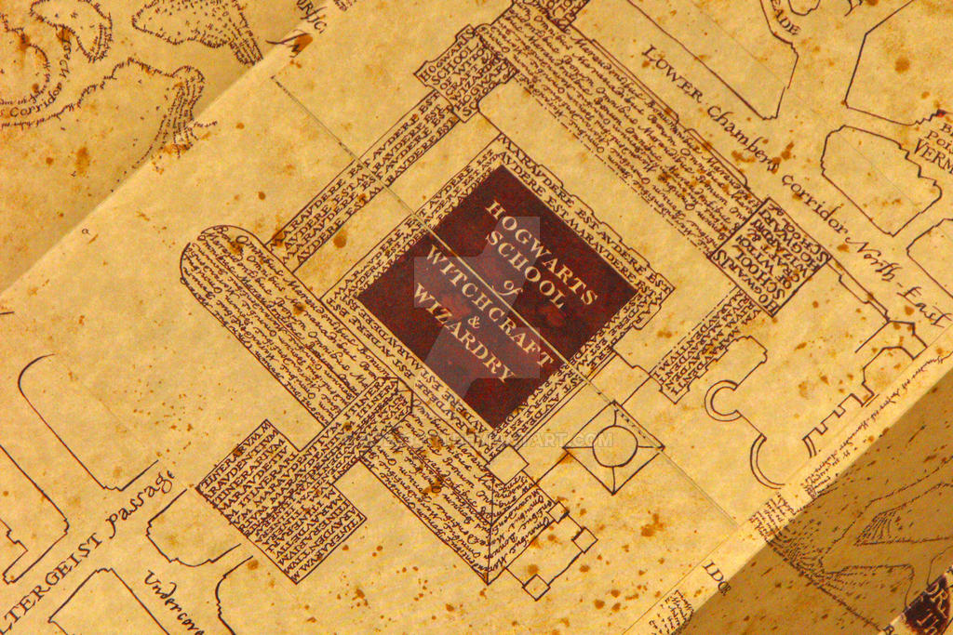



Blazor WASM
GraphQL
Umbraco Heartcore
Notes:
From here on we follow these three parties and see what they are up to. Lets get to know each of these characters now

Slide 5

Umbraco Heartcore

Slide 6

Headless SaaS offering of the Umbraco CMS
“Headless” because there is not “head” i.e. the website
Focus on storing and delivery of content
GraphQL API to query content, both published content and draft content

Slide 7

GraphQL
This Photo by Unknown Author is licensed under CC BY-SA

Slide 8

Ask for specific fields on specific types
Query syntax for your API
Exact fetching – no over fetching or under fetching
Response mirrors the query
Strongly-typed GraphQL Schema
Notes:
Show backoffice query and response

Slide 9
Schema Generation

Slide 10

GraphQL schema is generated from Content Types
Heartcore Schema has two types – Object Types & Query Type
Every time a Content Type is saved the schema is regenerated
The name of a GraphQL type is the alias of the Content Type in Pascal case. For e.g.: Character for a Content Type of alias character

Slide 11
Object Types
Query Type
TYPES
Representation of object
Get data operation type
Content Types
The Root Query
Notes:
Demo Heartcore backoffice.

Slide 12
Fields => Content Type Properties
Name
Scalar/Complex type
Resolvers
Name of the field
Concrete type the data resolves to
How to resolve the field to concrete data
Property Alias
Property Editors
Notes:
Demo Heartcore backoffice.

Slide 13
The Query type contains two fields allContent, and content to get a single content by id or url
For each content type two fields are generated on the Query type, one to query a single content item by id or url and another to get all content of that type. For e.g.: character and allCharacter for a Content Type of alias character
Notes:
Demo Heartcore backoffice. Look at some queries for ex character list and character

Slide 14
GraphQL Client Set Up

Slide 15
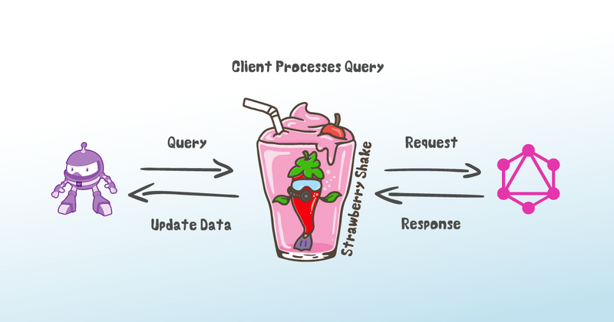
Strawberry Shake
Generate a C# client from GraphQL queries
Set up notes http://bit.ly/blazor-strawberryshake

Slide 16
Dynamic Rendering & Query Strings

Slide 17
Use the DynamicComponent to render components by type
Pass parameters as an IDictionary<string,object>
<DynamicComponent Type="@componentType" Parameters="@parameters" />

Slide 18
Supply component parameters from query string
Use [SupplyParameter] from query with [Parameter]
Can be used only with routed components

Slide 19
Custom Router

Slide 20
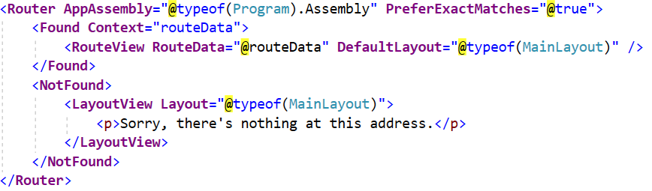
Built-in component in Blazor, implements the IComponent interface

Slide 21
Intercepting Navigation Events
JavaScript C#
Interception enabled?
Modifier key pressed?
Is there a target attribute?
Within scope of the base url?
NavigationManager
Router
NavigationManager Update the uri property Raise LocationChanged()
Update browser url and history Call notifyLocationChanged()

Slide 22

MISCHIEF MANAGED! http://bit.ly/blazor-graphql
Notes:
27 mins

Slide 23

Thanks for joining!
http://bit.ly/blazor-graphql

